Slide 1
Co-Author Based Academic Recommendation System

Slide 2
1
2
3
4
5
6
BACKGROUND
DATA
ALGORITHM
PREPROCESS
RESULT
NEXT
CONTENTS

Slide 3
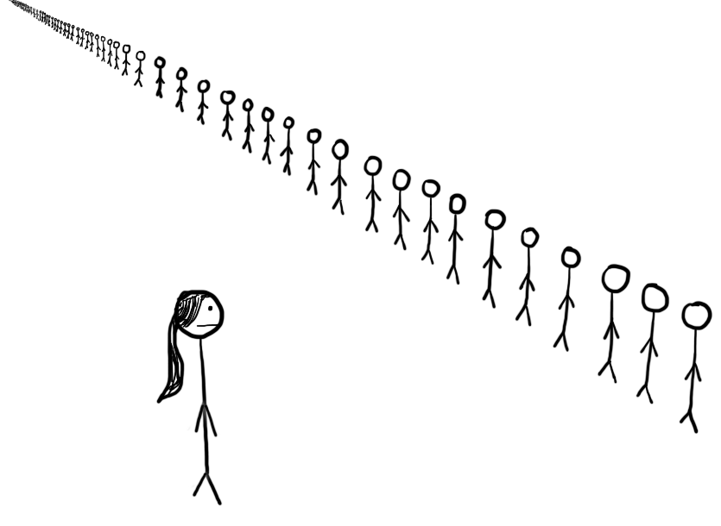

Why We Choose This Topic?
BACKGROUND
Whom To Cooperate With?
Which Paper To Read?
When they are to write a new paper, researchers always seek co-authors who are knowledgeable on the paper’s subject
Researchers have to read papers chosen from tons of papers to become familiar with the study fields
DATA
APPROACH
PREPROCESS
RESULT
NEXT

Slide 4


Why We Choose This Topic?
BACKGROUND
What We Want?
Take the author professional specialization and research experience into consideration!
DATA
APPROACH
PREPROCESS
RESULT
NEXT

Slide 5
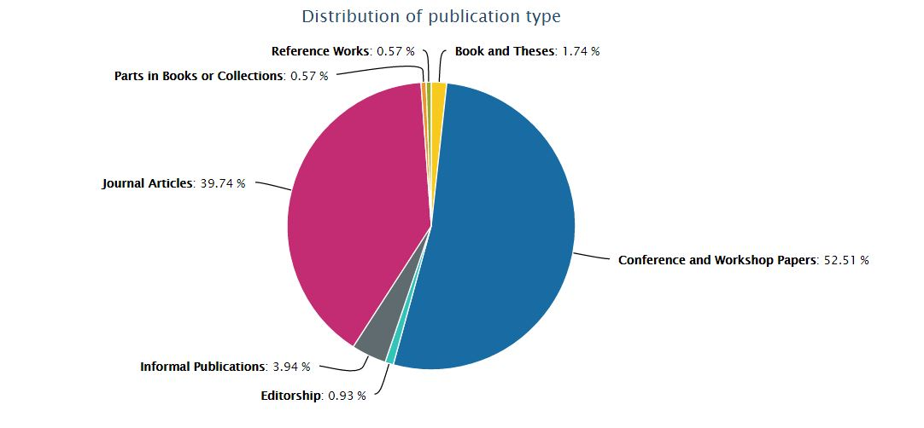
DBLP Computer Science Bibliography
BACKGROUND
What is it?
DATA
On-line reference for bibliographic information on major computer science publications.
APPROACH
APPROACH
标签文字
标签文字
PREPROCESS
How large is it?
RESULT
DBLP contains 3,749,969 publications written by 1,899,133 authors and published on 4,112 conferences and 1,525 journals.
NEXT

Slide 6
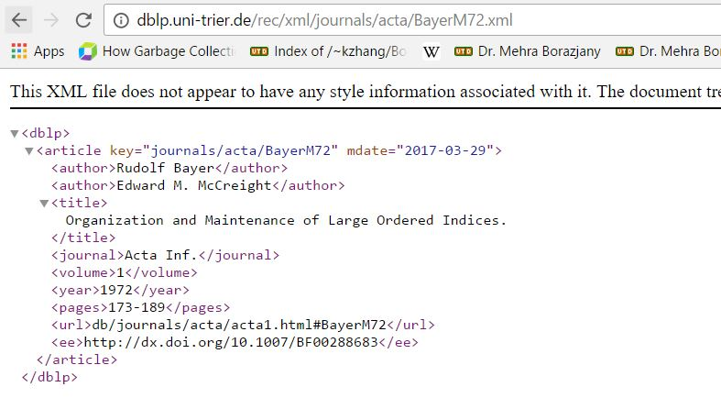
DBLP Computer Science Bibliography
BACKGROUND
DATA
How Does it Look Like?
It’s well-formed in XML file.
The website also provide URLs to retrieve specified record.
APPROACH
APPROACH
标签文字
标签文字
PREPROCESS
RESULT
NEXT

Slide 7
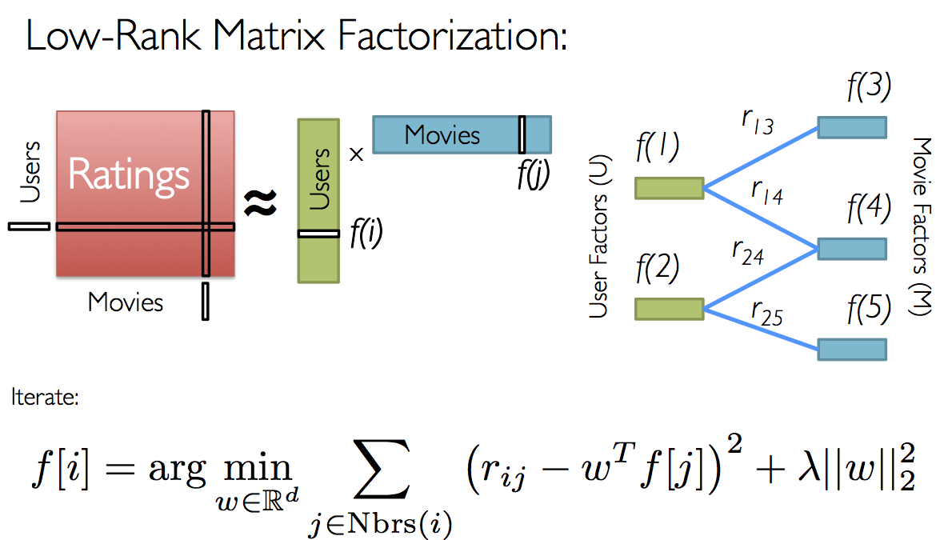
Collaborative Filtering With ALS
BACKGROUND
DATA
APPROACH
PREPROCESS
RESULT
NEXT

Slide 8
Collaborative Filtering With ALS
BACKGROUND
Domain Free
A
DATA
Provide Generally Better Prediction
B
Convert Nonconvex Problem Into Two Quadric Problems
APPROACH
C
Can Be Easily Parallelized On Distributed Computing System
D
PREPROCESS
E
Cold Start Problem
RESULT
NEXT

Slide 9
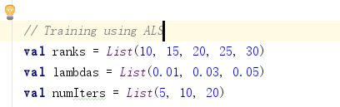
Collaborative Filtering With ALS
BACKGROUND
DATA
Only consider the (author, author) pair with rating 1.
Split whole data set into training(60%), test(20%), validation(20%).
The rank parameter was tuned from [10, 15, 20, 25, 30]
The lambda parameter was tuned from [0.01, 0.03, 0.05]
The #iteration parameter was tuned from [5,10,20]
APPROACH
PREPROCESS
RESULT
NEXT

Slide 10
Data Preprocessing
BACKGROUND
Weak Connections Are Filtered
Reduce Scale of Training Dataset & Improve Training Efficiency
DATA
APPROACH
PREPROCESS
RESULT
NEXT
#Cooperation < 3
Undirected Acyclic Graph

Slide 11
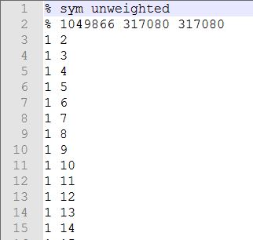
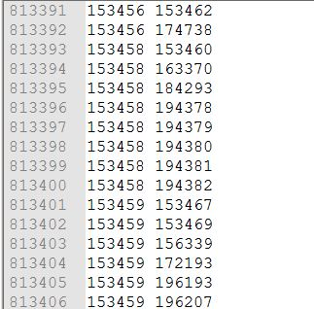
Data Preprocessing
BACKGROUND
Co-Author Dataset
Author-Paper Dataset
DATA
APPROACH
PREPROCESS
RESULT
NEXT

Slide 12
Experiment Result
BACKGROUND
DATA
The best model of co-author dataset is trained with:
The best model of author-paper dataset is trained with:
APPROACH
rank | 30
lambda | 0.05
#iterations | 20
Training MSE | 0.1307
Testing MSE | 0.1312
rank | 30
lambda | 0.05
#iterations | 20
Training MSE | 0.3165
Testing MSE | 0.3161
PREPROCESS
RESULT
NEXT

Slide 13
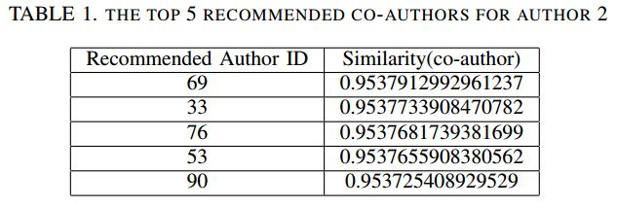
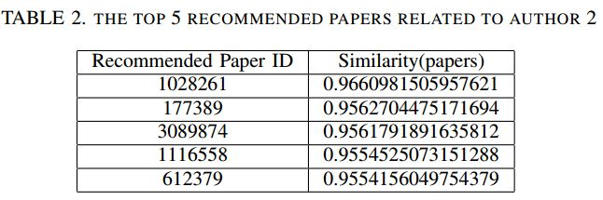
Experiment Result
BACKGROUND
2
2
DATA
APPROACH
PREPROCESS
RESULT
NEXT

Slide 14

What’s Next?
BACKGROUND
The recommendation model is trained well with our data as it gives minimal mean square error to our dataset.
However there are still some improvements can be made to make our recommendation system better.
Remember?
For each connection (author-author / author-paper) were abstracted into 1 and 0 after filtering by the number of co-existence.
DATA
APPROACH
How To Improve It In The Future?
Target Locked!
Weighting ratings by the number of connections and normalize them.
PREPROCESS
1?
RESULT
Nice Recommendation!
AND
NEXT

Slide 15
Thank You!
Presented By:
Mingyue Sun, Fei Chen, Tim Lawrance Fiebrantz, Xiangru Zhou, Xiangdong Wu, Yanjun Xiong

